Slide 1

ANALYSIS OF MULTILAYER Neural NETWORK STRUCTURES [AMNnS]
Guided By:-
Dr. Shunmuga Velayutham C.
Associate Professor & Vice Chairperson,
Computer Science, School of Engineering,
Coimbatore
JISHNU P
CB.EN.P2AID19017

Slide 2
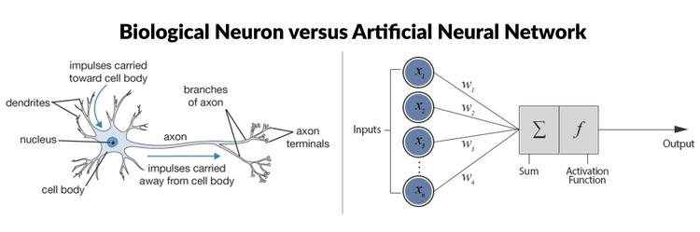
INTRODUCTION
An Artificial Neural Network (ANN) is a computational model based on the structure and functions of biological neural networks.
It is composed of large number of highly interconnected processing elements(neurons) working in unison to solve a specific problem.

Slide 3
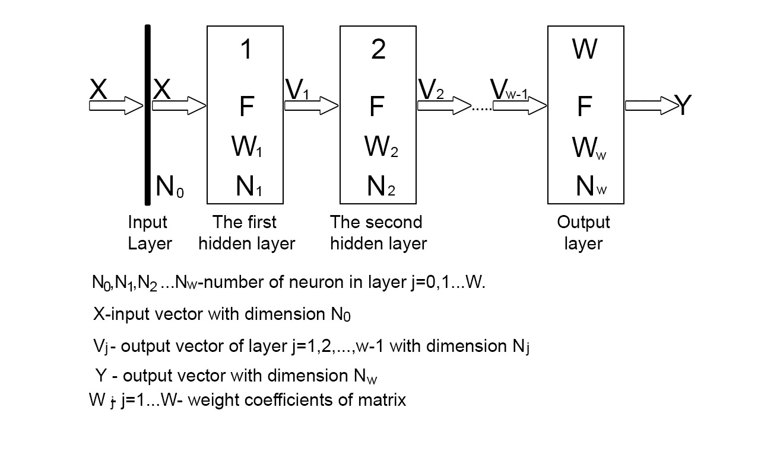
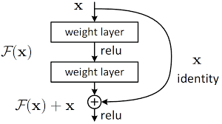

Objective
Compare and contrast between Direct connected network and Network with jumping
Connections .

Slide 4
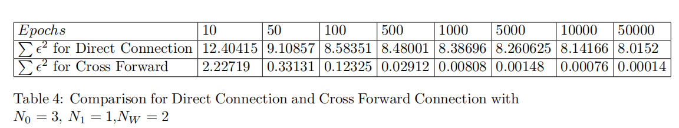
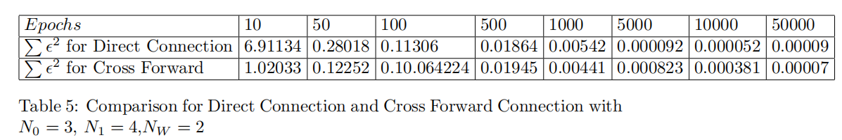
related works
Analysis of Multilayer Neural Networks with Direct and Cross-forward Connection - Stanis law P laczek and Bijaya Adhikari

Slide 5
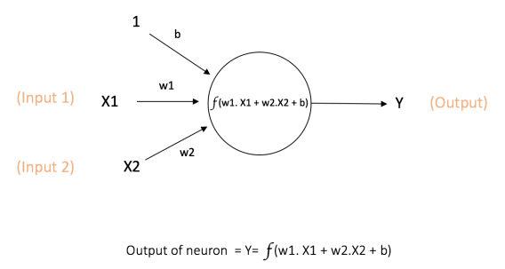
BASICS
NEURONS
Each neuron is a mathematical operation that takes it's input, multiplies it by it's weights and then passes the sum through the activation function to the other neurons.

Slide 6
BASICS
How Neural Networks Learn?

Slide 7
BASICS
Hyperparameters are important because they directly control the behaviour of the training algorithm and have a significant impact on the performance of the model is being trained.
Learning Rate
Number of Epochs
Hidden Layers
Hidden Units
Activations Functions

Slide 8
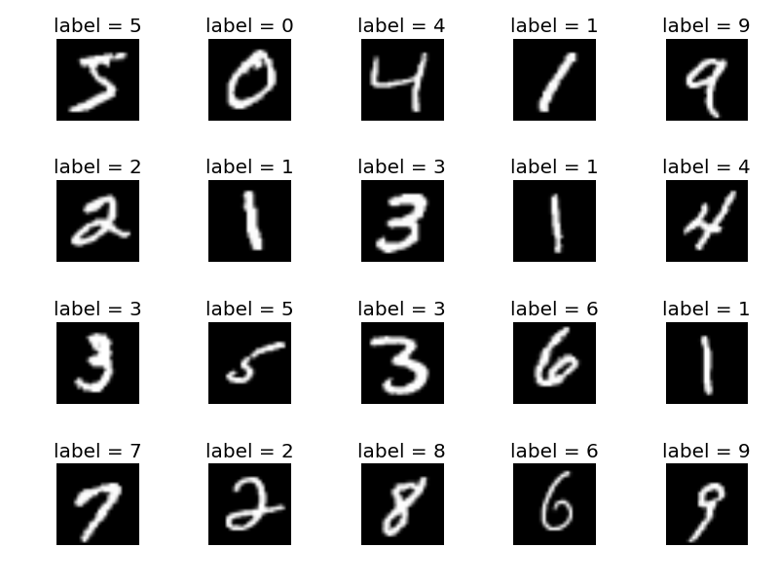
Image classification using mnist dataset
The MNIST database (Modified National Institute of Standards and Technology database) is a large database of handwritten digits.

Slide 9
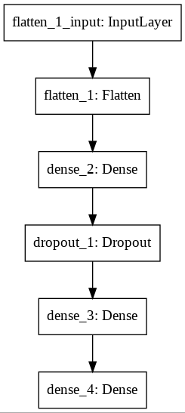
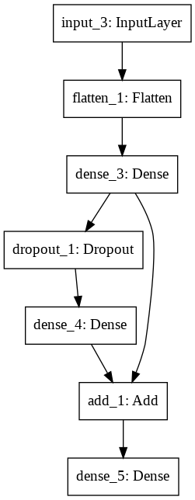
MODEl

Slide 10
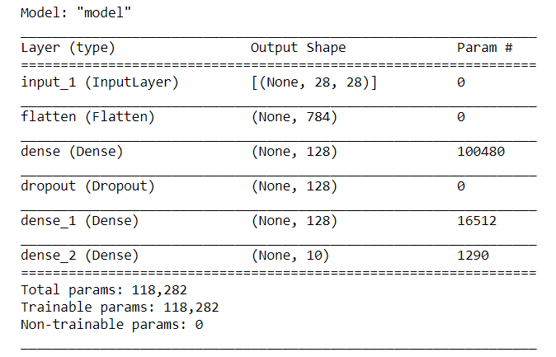
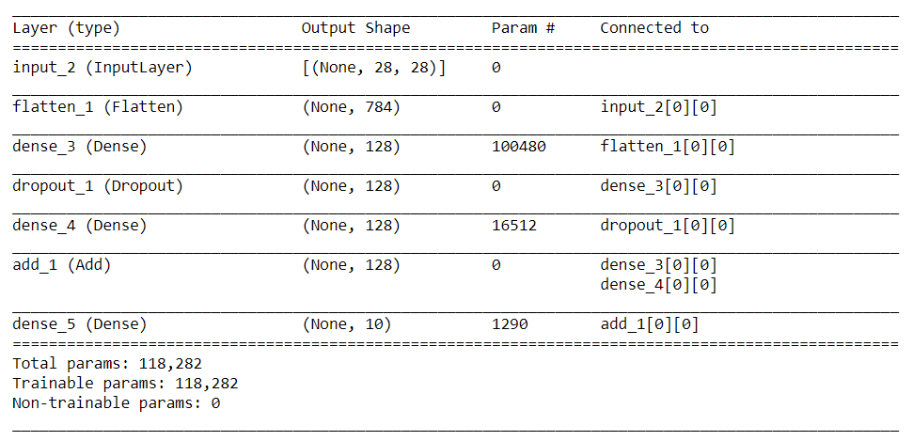
MODEl SUMMARY

Slide 11
experiments

Slide 12
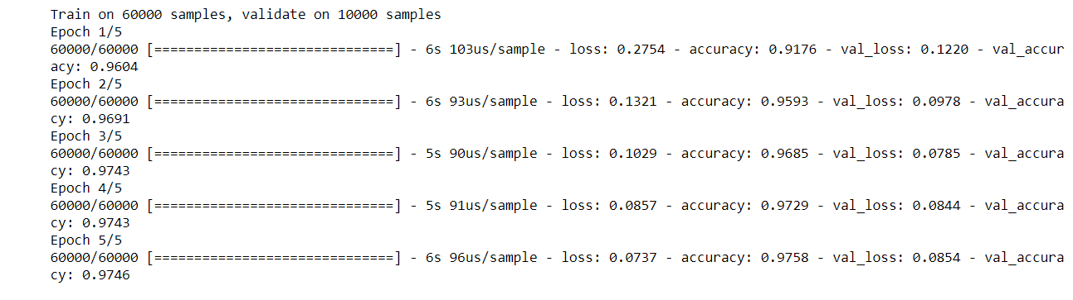
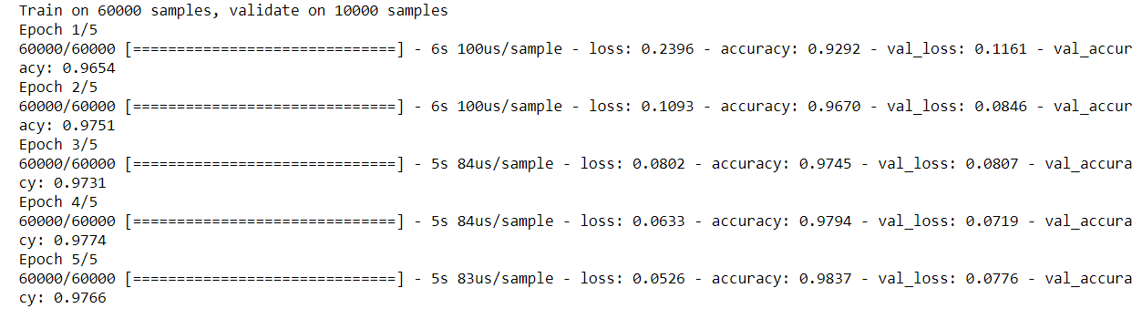
Epochs 5

Slide 13
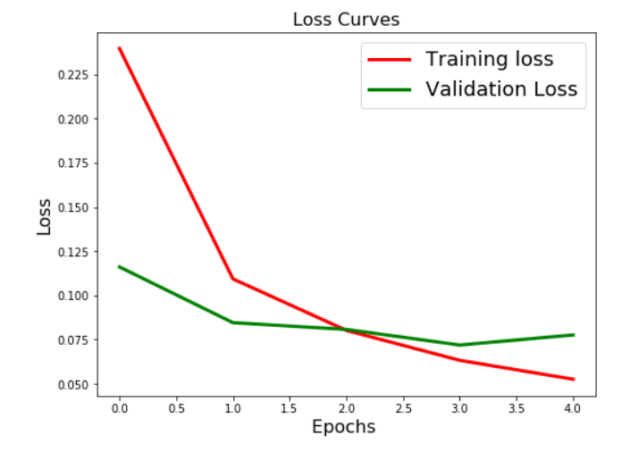
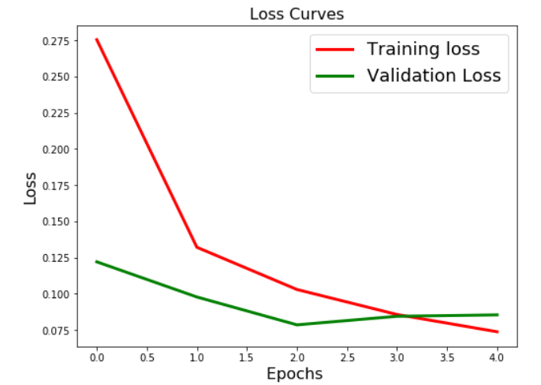
Ep0chs 5

Slide 14
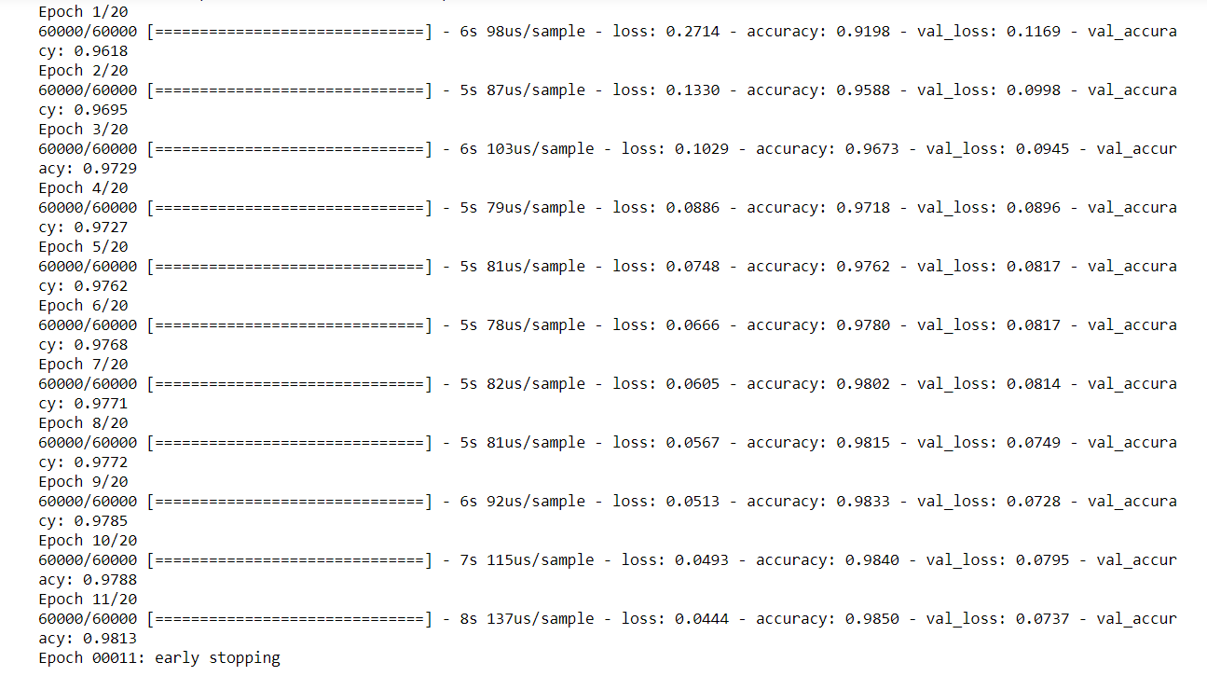
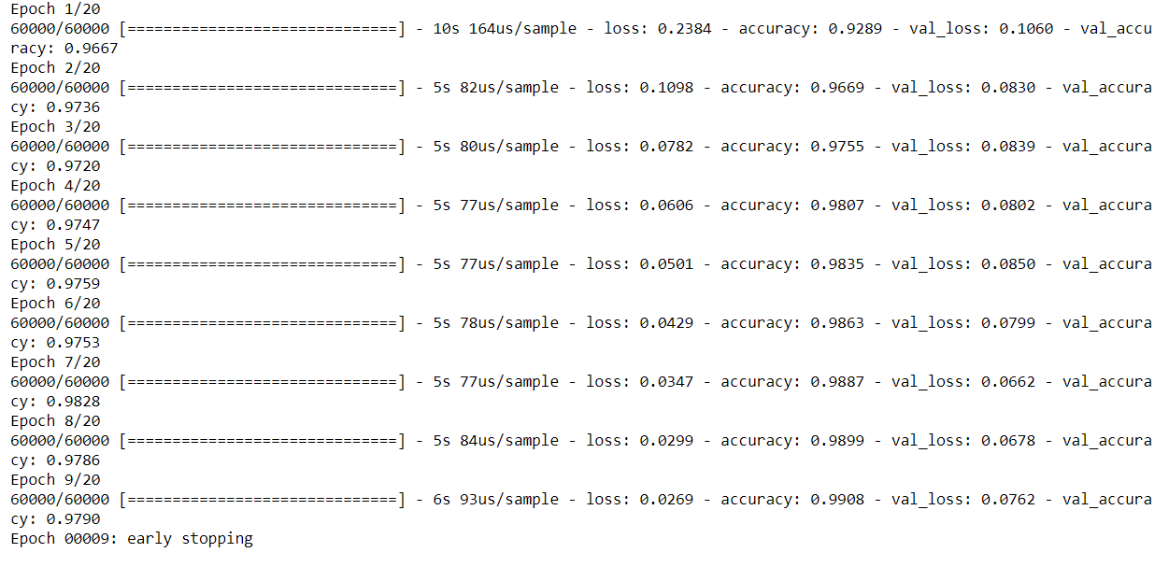
Epochs 20

Slide 15
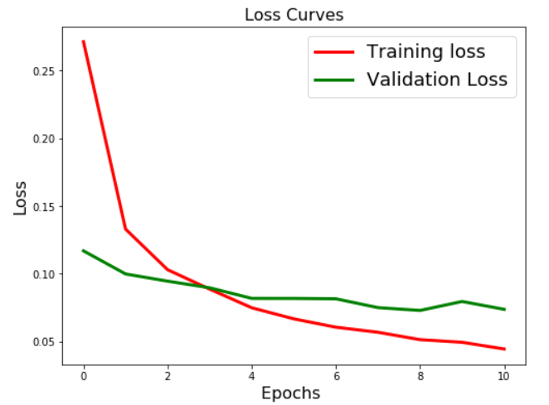
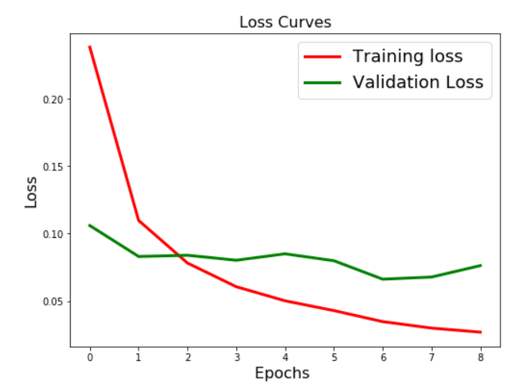
EPOCHS 20

Slide 16
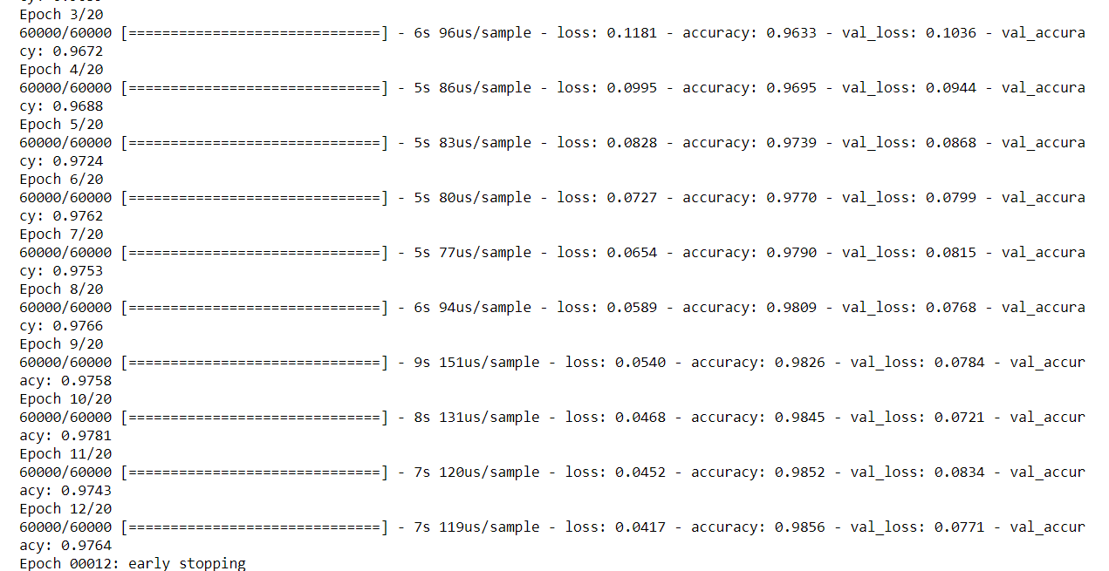
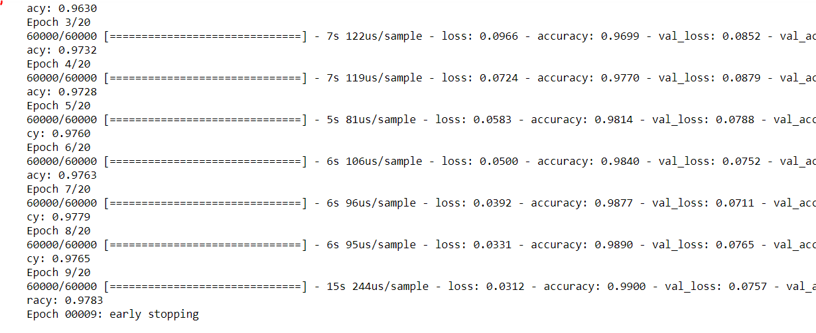
Tanh in middle layers

Slide 17
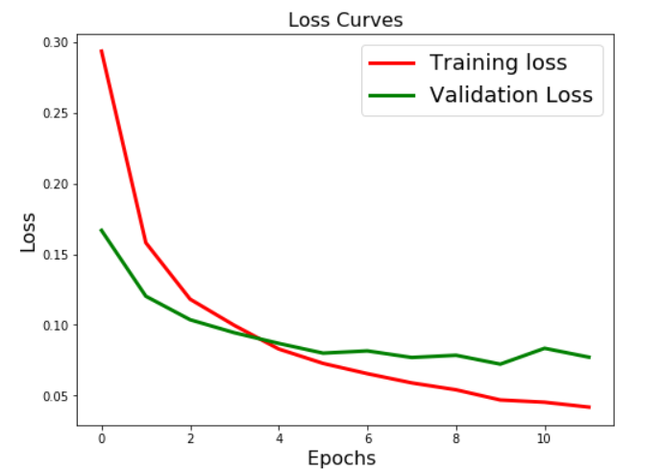
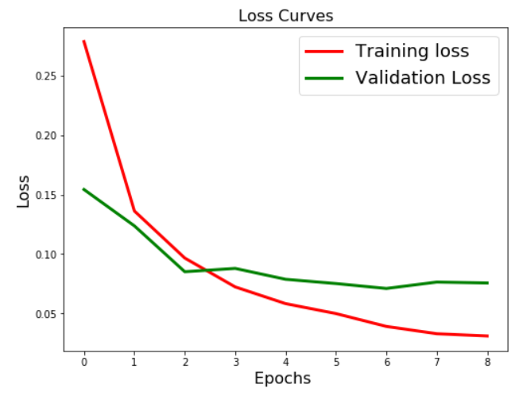
Direct vs jumping connection

Slide 18
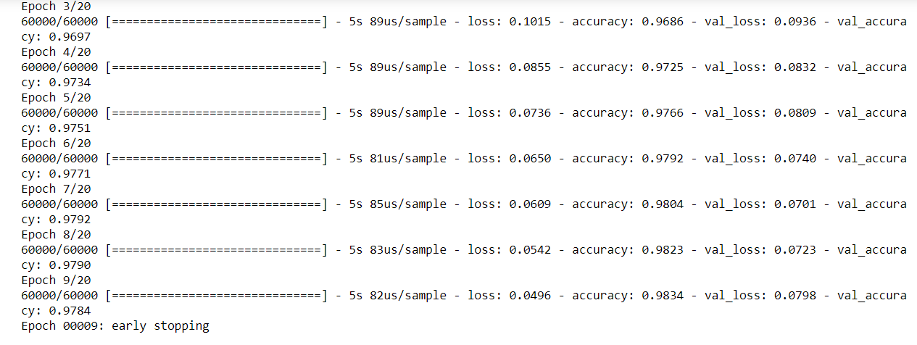
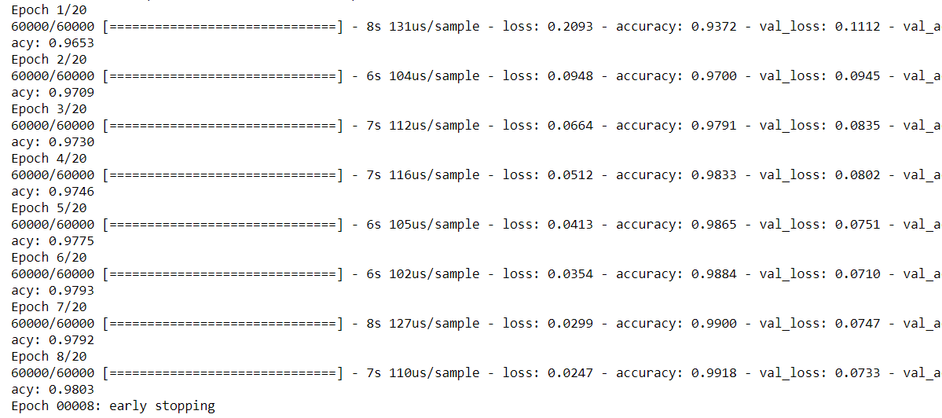
256 hidden units

Slide 19
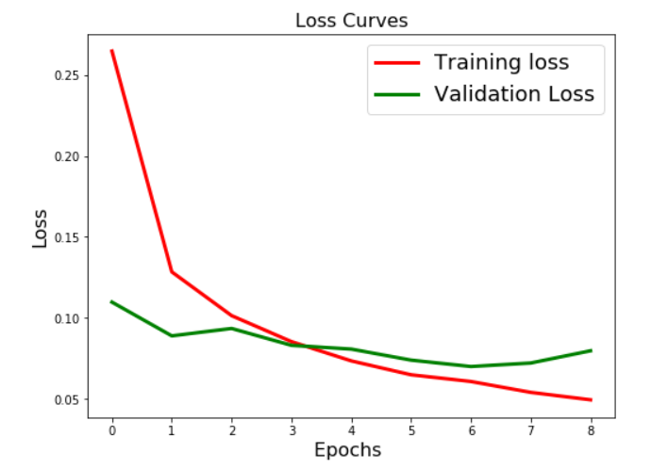
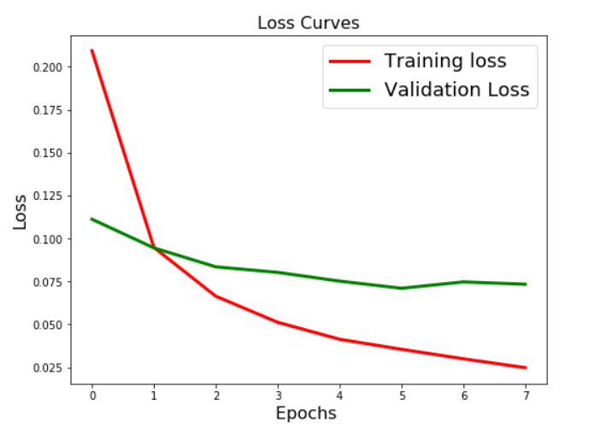
Direct vs jumping connection

Slide 20
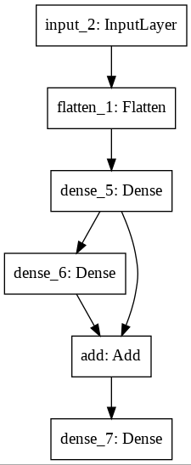
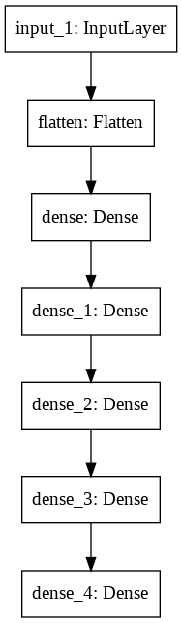
Relation with number of layers

Slide 21
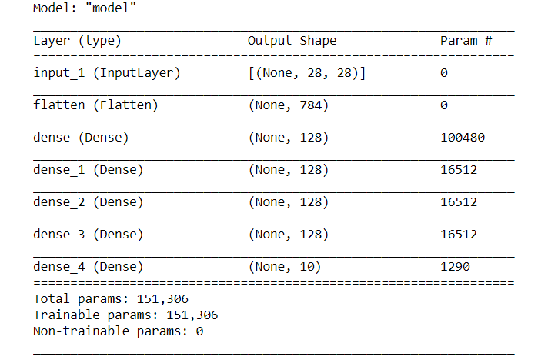
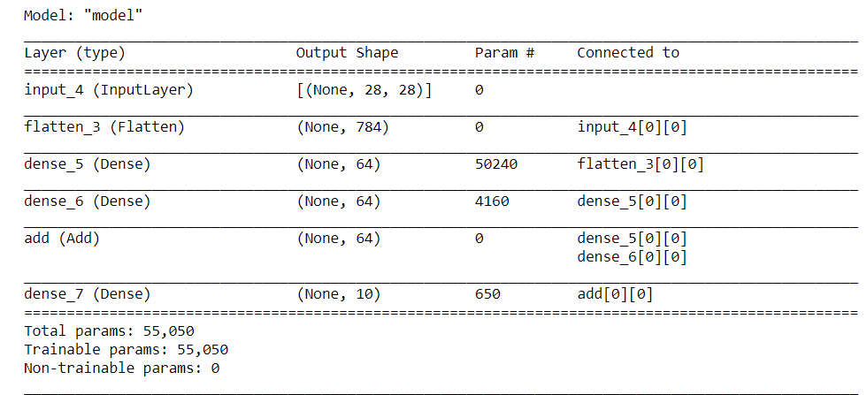
model summary

Slide 22
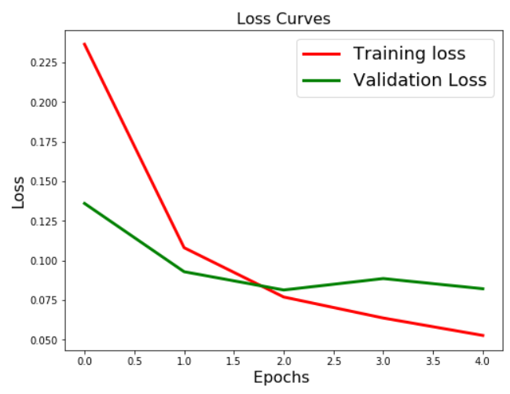
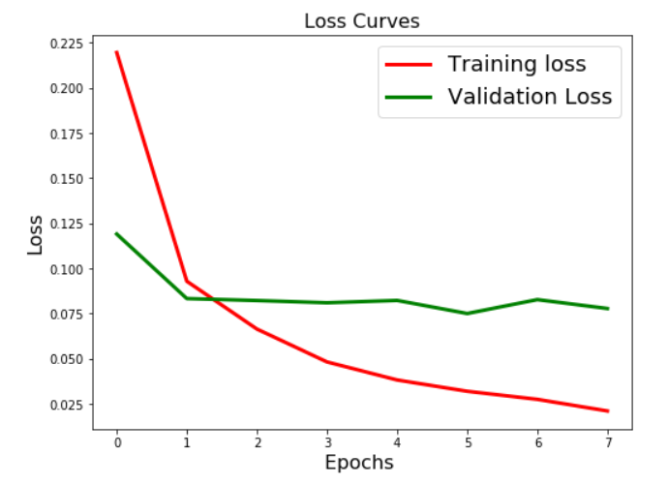
Direct vs jumping connection

Slide 23
INFERENCES
If we are confused about which activation function to use, then simply use RELU as it is a general activation function. This assumption worked well for me.
If your output contains more than two classification then, softmax function is very natural choice for output layer.
Jumping connection accelerates the convergence of the network.
we can replace a neural network with another neural network having jumping connections with less number of layers.
We can save the trainig time by using jumping connections in the network.

Slide 24
conclusion
From the Comparison study, it is clear that e can use neural network with jumping connections to attain better convergence with less number of epochs.
ResNet,Residual Networks is a classic neural network used as a backbone for many computer vision tasks. This model was the winner of ImageNet challenge in 2015. The fundamental breakthrough with ResNet was it allowed us to train extremely deep neural networks with 150+layers successfully.

Slide 25
REFERENCES
Neural Networks: A Classroom Approach by Satish Kumar
https://engmrk.com/residual-networks- resnets/?utm_campaign=News&utm_medium=Community&utm_source=DataCamp.com
https://towardsdatascience.com/backpropagation-and-batch-normalization-in-feedforward-neural-networks-explained-901fd6e5393e
https://towardsdatascience.com/activation-functions-neural-networks-1cbd9f8d91d6
https://stats.stackexchange.com/questions/56950/neural-network-with-skip-layer-connections
https://towardsdatascience.com/introduction-to-resnets-c0a830a288a4

Slide 26
THANK YOU !

